Slide 1
Name:KevinLeslie.S
REG NO:711721243047
DEPARTMENT:B.TECH Artifical Intelligence And DataScience
3/21/2024 Annual Review

Slide 2
PROJECT TITLE RICE CLASSIFICATION USING CNN
3/21/2024 Annual Review

Slide 3


AGENDA 1.Problem Statement 2.Project Overview 3.End Users 4.Our Solution and Proposition 5.Key Features 6.Modelling Approach 7.Results and Evaluation 8.Conclusion
3/21/2024 Annual Review

Slide 4

PROBLEMSTATEMENT
Advanced Image Recognition: Utilizing cutting-edge technology for rapid and accurate classification of rice based on quality and variety.
Quality Assurance: Ensuring that only top-quality rice reaches consumers, enhancing customer satisfaction and trust in the product.
Time-saving Solution: By automating the sorting process, farmers and processors save valuable time, allowing for increased productivity and efficiency.
3/21/2024 Annual Review

Slide 5

PROJECT OVERVIEW
Implementation of an automated rice classification system leveraging advanced image recognition technologies.
Utilization of convolutional neural networks (CNNs) to classify rice based on quality, variety, and defects, facilitating efficient sorting processes.
Aim to streamline operations for farmers and processors, ensuring consistent supply of high-quality rice to consumers while optimizing efficiency in the rice supply chain.
3/21/2024 Annual Review

Slide 6

WHO ARE THE END USERS?
Farmers: They can utilize the system to sort their harvested rice quickly and accurately, ensuring that only high-quality grains are sent to market.
Rice Processors: Companies involved in rice processing can benefit from the system by automating the sorting process, reducing labor costs, and improving efficiency in their operations.
Consumers: Ultimately, consumers benefit from receiving consistently high-quality rice products, as the system ensures that only top-grade grains reach the market.
3/21/2024 Annual Review

Slide 7

YOUR SOLUTION AND ITS VALUE PROPOSITION
Accuracy: Leveraging CNNs ensures highly accurate classification of rice based on quality, variety, and defects, surpassing traditional methods in precision.
Efficiency: The automated nature of CNNs streamlines the sorting process, enabling rapid classification of large volumes of rice, thus saving time and resources for farmers and processors.
Cost-effectiveness: By reducing the need for manual labor in sorting, the CNN-based solution cuts down on operational costs for rice processors, leading to increased profitability.
Consistency: Consistent classification standards are upheld throughout, ensuring that only high-quality rice reaches consumers, thereby enhancing brand reputation and customer satisfaction.
Technological Advancement: Embracing CNN technology demonstrates a commitment to innovation and staying ahead in the rice industry, positioning businesses as leaders in modern agricultural practices.
3/21/2024 Annual Review

Slide 8

THE WOW IN YOUR SOLUTION -Real time detection -High accuracy in detecting a object -potential for integration with existing surveillance systems
3/21/2024 Annual Review

Slide 9
MODELLING
1. Data Collection and Preparation:
Dataset: Gather a dataset of rice images. Ensure that the dataset contains a variety of rice types and that each image is labeled with its corresponding rice type.
Data Preprocessing: Resize all images to a consistent size, convert them to grayscale or RGB format as per your preference, and normalize pixel values to the range [0, 1].
2. Model Architecture:
Convolutional Layers: Design the CNN architecture. Typically, it consists of multiple convolutional layers followed by max-pooling layers to extract features and reduce dimensionality.
Flattening Layer: Flatten the output from the convolutional layers to prepare it for the fully connected layers.
Fully Connected Layers: Add one or more fully connected layers to the network for classification.
Output Layer: The output layer should have neurons equal to the number of classes (types of rice) with softmax activation for multi-class classification.
3/21/2024 Annual Review

Slide 10
.
3. Training:
Loss Function: Use categorical cross-entropy loss, suitable for multi-class classification problems.
Optimizer: Adam optimizer is commonly used for its adaptive learning rate properties.
Training: Split the dataset into training and validation sets. Train the model on the training set while monitoring performance on the validation set to avoid overfitting.
Data Augmentation: Augment the training data by applying random transformations like rotation, flipping, and shifting to increase model generalization.
4. Evaluation:
Accuracy Metrics: Evaluate the model's performance using metrics such as accuracy, precision, recall, and F1-score.
Confusion Matrix: Analyze the confusion matrix to understand which classes are being misclassified.

Slide 11
.
5. Fine-tuning and Optimization:
Hyperparameter Tuning: Experiment with different hyperparameters like learning rate, batch size, and network architecture to optimize performance.
Transfer Learning: If you have limited data, consider using pre-trained CNN models like VGG, ResNet, or Inception as a base and fine-tune them for rice classification.
6. Deployment:
Once satisfied with the model's performance, deploy it in a suitable environment for inference, such as a web application, mobile app, or embedded system.

Slide 12
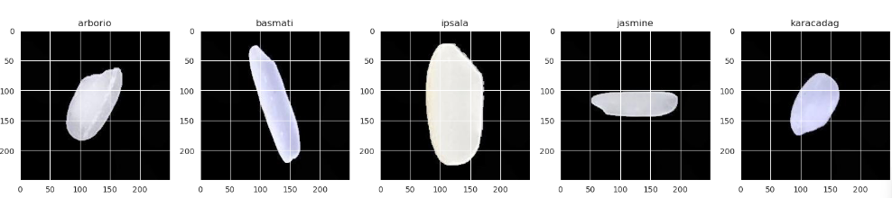
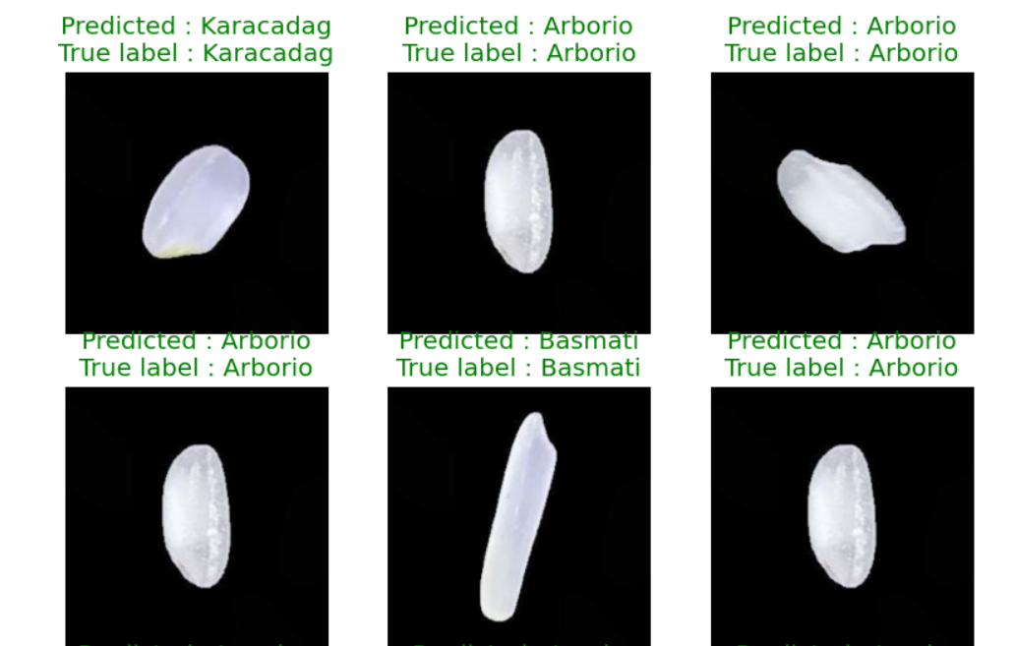
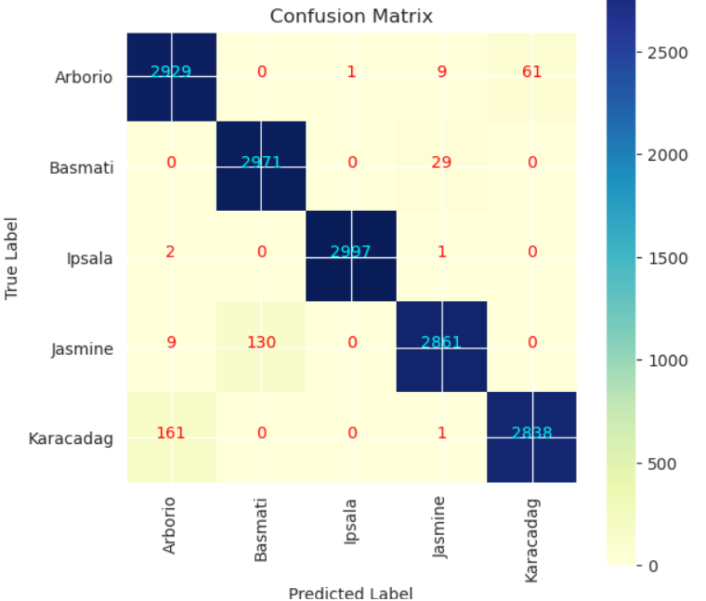
RESULTS
Demo Link
3/21/2024 Annual Review

